Slide 1
Wedges
Dr. Jacob Moore
Associate Professor of Engineering
Penn State Mont Alto

Slide 2
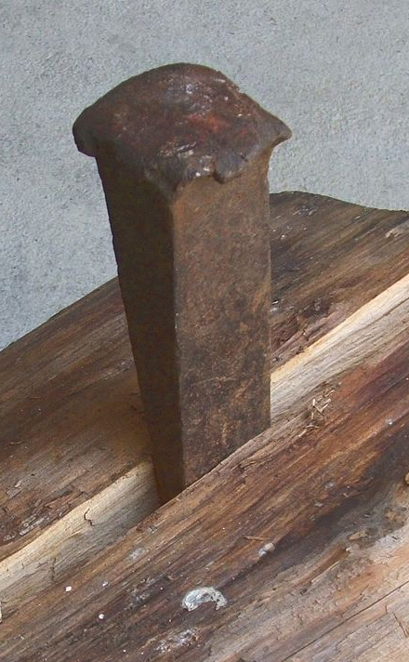
Wedges
$$F_{push}$$
A wedge is a thin ‘wedge shaped’ object that is forced in between two objects in order to separate them.
A wedge can cause huge normal forces separating the two bodies with a relatively small pushing force, but significant friction forces will also exist that fight the pushing force
$$F_{normal}$$
$$F_{friction}$$
$$F_{friction}$$
$$F_{normal}$$

Slide 3
Analyzing Wedges
These are more or less equilibrium problems
Draw a free body diagram of the wedge and/or the body/bodies being moved by the wedge.
Remember to include...
The pushing force on the wedge
The normal forces (always perpendicular to the surfaces in contact
The friction forces (always opposing potential sliding)
We will generally assume sliding or in some cases impeding motion.
Write out the equilibrium equations (the wedge assumed to be in equilibrium).
Use the coefficients of friction to relate normal forces and friction forces.
Solve the equilibrium equations for unknowns

Slide 4
Wedges
Imagine that a heavy safe is snuggly pressed up against a wall. In order to move the safe out from the wall you place a steel wedge as shown between the wall and the safe and press the wedge between the two to create a space. What force is needed to move the safe?
$$F_{push}$$

Slide 5












Setting Up Free Body Diagrams
First, we draw a free body diagram of each body.
To simplify the analysis, we can replace the friction forces with the coefficient of friction times the corresponding normal force
Assume Coefficient static and of kinetic friction = .15 for all surfaces
$$F_{push}$$
$$F_{f2}$$
$$F_{N2}$$
$$.15∗F_{N2}$$
$$F_{f1}$$
$$F_{w}$$
$$.15∗F_{N1}$$
$$F_{f2}$$
$$.15∗F_{N2}$$
$$F_{N1}$$
$$F_{f3}$$
$$F_{N2}$$
$$.15∗F_{N3}$$
$$F_{N3}$$

Slide 6

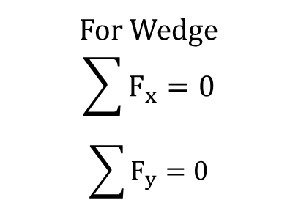

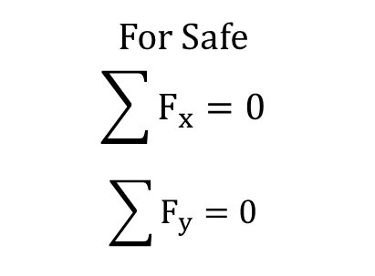
Setting Up the Equilibrium Equations
Now with the simplified diagrams, we will assume that each body is in equilibrium and write out and solve the equilibrium equations (just sum of forces in the x and y directions, we usually avoid moment equations for wedge problems).
For Wedge
$$\sum{F_{x}=0}$$
$$\sum{F_{y}=0}$$
$$F_{push}$$
$$F_{N2}$$
$$.15∗F_{N2}$$
For Safe
$$\sum{F_{x}=0}$$
$$\sum{F_{y}=0}$$
$$F_{w}$$
$$.15∗F_{N1}$$
$$.15∗F_{N2}$$
$$F_{N1}$$
$$F_{N2}$$
$$.15∗F_{N3}$$
$$F_{N3}$$

Slide 7
Solving the Equations
Once you have your equilibrium equations set up, you just have to solve them like you would for any other equilibrium problem.
Just make sure you have enough equations to solve for all the unknowns.
Remember to apply Newton’s Third Law in multi-body problems

Slide 8
Thanks for Watching
See other engineering mechanics videos and access the full tool at…

Slide 9
Wedges Worked Example
A heavy safe is being pushed away from a wall with a wedge as shown to the right. Assume the wedge has an angle of 5 degrees, the coefficient of friction (static and kinetic) between the wedge and the safe is .16, and the coefficients of friction (static and kinetic) between the wedge and the wall and the safe and the floor are both .35. What is the pushing force required to move the safe out from the wall?
$$F_{push}$$
Mass of safe = 150 kg
Angle of wedge = 5º
Coefficient static and of kinetic friction = .16 for wedge and safe and .35 for everything else

Slide 10





Wedges Practice Problem
A wedge as shown below is being used to lift the corner of the foundation of a house. How large must the pushing force be to exert a one ton (2000 lb) lifting force?
$$2000 lbs$$
$$μ_{s}=.15$$
$$μ_{s}=.05$$
$$θ=10°$$
$$F_{push}$$

